Slide 1
Autoencoder Classifier for Wafer resistance test map

Slide 2
Autoencoder
Autoencoder comprises of two parts of network, encoder and decoder.
Encoder extracts features from the image into “code”.
“Code” is actually compressed image or image consists only necessary features.
The “code” will then be decoded and forms the reconstructed image.

Slide 3
Encoder
In this context, the image is downsized using 3 convolution layers with strides (2,2).
This will downsize the image (42,42) -> (21,21) ->(11,11) ->(6,6)
At the encoded layer, we will have 40 neurons with shape (6,6).
This should capture all the necessary features in the images in the form of different compressed images.
If there are less neuron, it tends to be losing information/features.
Further compression of image may also lead to wrong classification of images since “saw” and “grind” defects tend to be at edge of wafer rather than at the center.

Slide 4
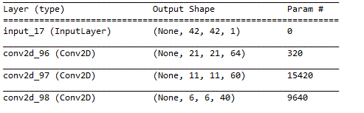
Encoder
In our context, encoder compress the image size. Number on the code layer should be sufficient in describing all the features or the information will be lost
At coded layer, 40 neurons of 6x6 image output

Slide 5
Decoder
The “code” which is the resultant of encoder, will now be decoded back to its original shape.
In this context, we will be following the same path:
(6,6)->(11,11)->(21,21)->(42,42)
Hence, upsampling layer is used. Size (2,2) is chosen so the image is twice in row and column. The padded row/column shares same value.
However, certain layer involves odd number of row and column.
Hence, lambda layer is used to remove last row and last column.
(6,6)->(12,12)->(11,11)->(22,22)->(21,21)->(42,42)

Slide 6
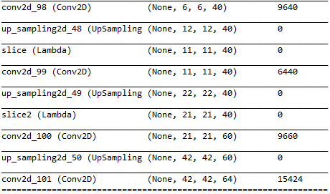
Decoder
Upsampling will pad the same value. Hence, convolution layer with stride (1,1) is needed in order to increase accuracy of the re-constructed image.
Starting from coded layer, up sampling, slicing if necessary and then convolute the image. It forms 42x42 image so that self encoding is possible.

Slide 7
Training of autoencoder
The autoencoder is unsupervised learning. This is because both input and output is actually the same image.
The feature that it gathers is at the center “code” layer. The code will then used as input of classfier.
Hence, RMS is used to compile the model. This is because output is now an image.

Slide 8
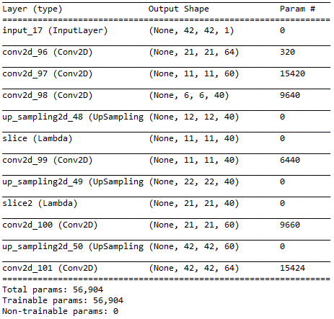
Training of autoencoder
Full autoencoder

Slide 9
Classifier
After training of autoencoder, the “code” can then be used to represent the extracted features.
However, autodecoder does not know how to map the extracted features to user classification.
Hence, dense layer can be connected to the output of “code” layer.
The final dense layer must have number of neuron fits the user defined number of classes. Each neuron represent likelihood to belong to each class.

Slide 10
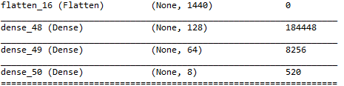
Classifier
Already Trained Encoder
Untrained Classifier based on encoded input.
8 classes at the output.
8 neurons with softmax activation at the last layer.

Slide 11


Classifier
After training of autoencoder, the encoder is trained, so training of these layer must be disabled.
The dense layer will instead be trained by fitting input to input image and output to the user defined class.
Categorical crossentropy is used for fitting as it is now in categorical values. Adam optimizer is used here.

Slide 12
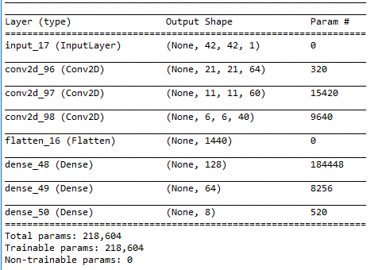
Classifier
Complete classifier

Slide 13
Training and Prediction Sequence
Unlabeled Train Data for autoencoder training
Labeled Train Data for classifier training
Using Labeled Test Data to generate confusion matrix and other performance matrices on Classfier
Using the Classfier predicts the class for unlabeled test data. Compare against reconstructed image from autoencoder

Slide 14
Training Procedure
At first, autoencoder is trained using unlabeled data. This is because autodecoder is using unsupervised learning.
Then, the classifier will be trained using technician label data since the classifier will need information of final classification of known extracted features.
This will be two different set of data.

Slide 15
Prediction
Using 8:2 test split, both labelled and unlabeled data are split.
Train labelled data used for training the autoencoder then train label data used to train classifier.
The classifier will then make classification on unlabeled data.

Slide 16
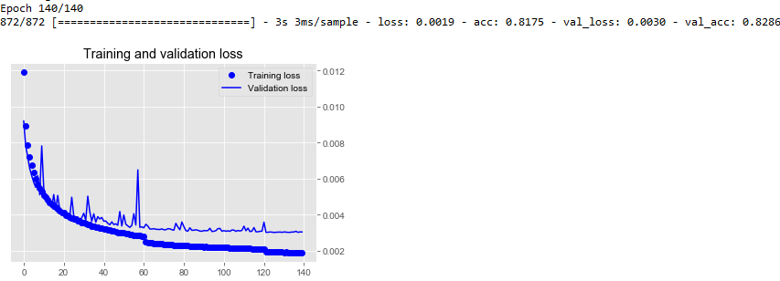
Result – Autodecoder Training
Autodecoder is lossy but it is still acceptable as it is used for classification purpose. Accuracy reaching 82.86% while value loss is around 0.003. However, as most of the important features are actually sharpen, it helps the classification later.

Slide 17
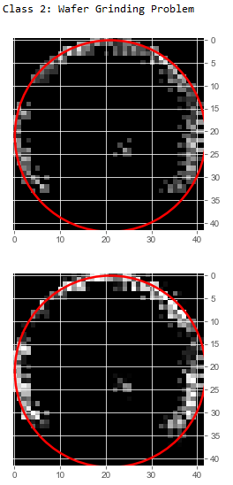
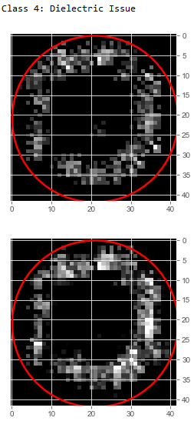
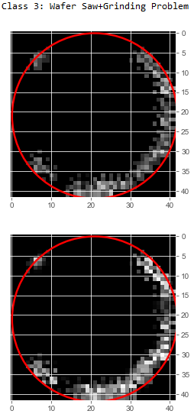
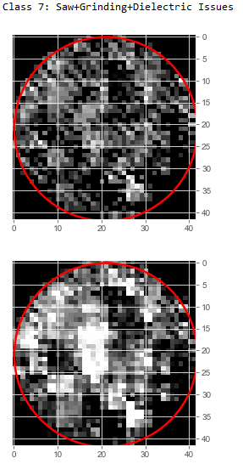
Result – Autodecoder Training
Reconstructed image sharpen important features in the wafer map

Slide 18
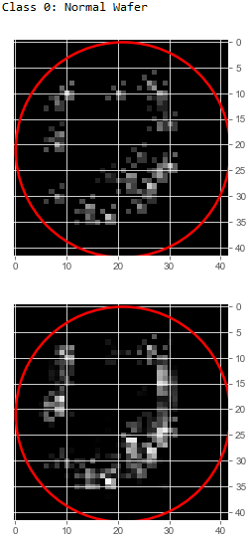
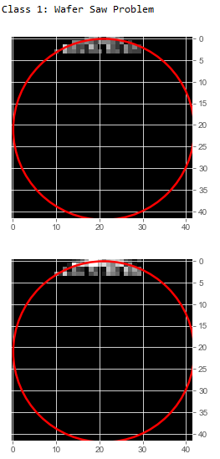
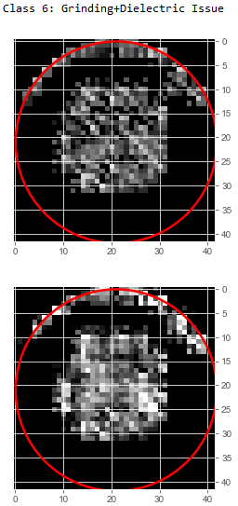
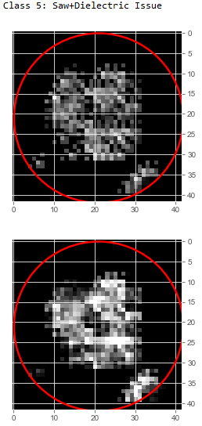
Result – Autodecoder Training

Slide 19
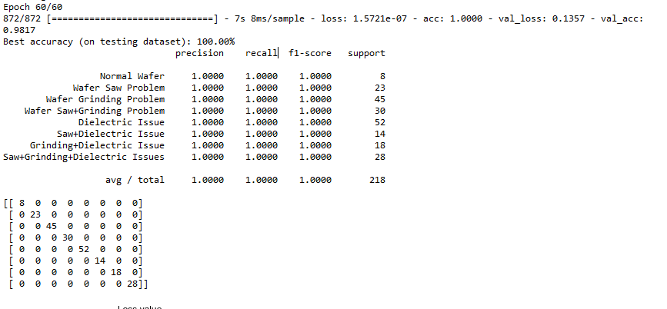
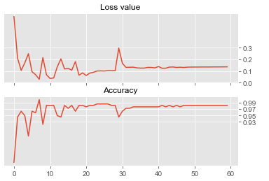
Result – Classifier Training
Classfication is achieving 98.17% at epoch 60.

Slide 20
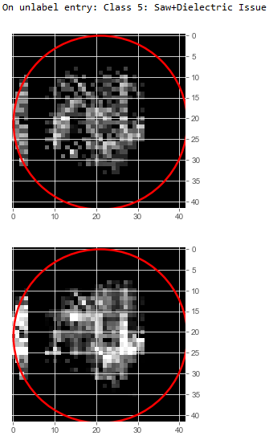
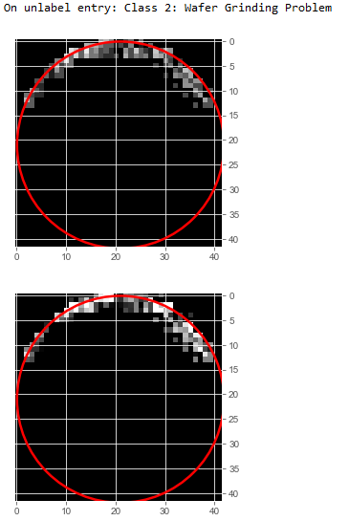
Result – Classifier Prediction
The correctly predicted class for the wafer map.

Slide 21
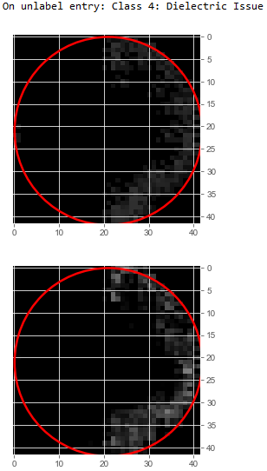
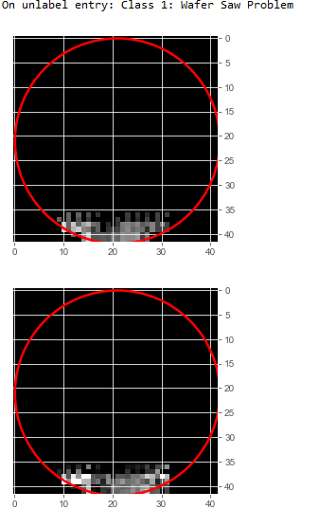
Result – Classifier Prediction

Slide 22
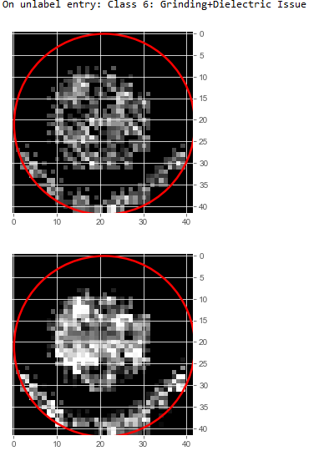
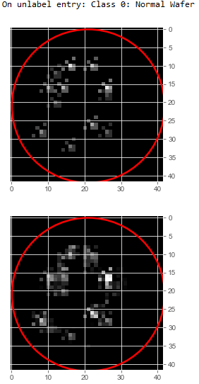
Result – Classifier Prediction

Slide 23
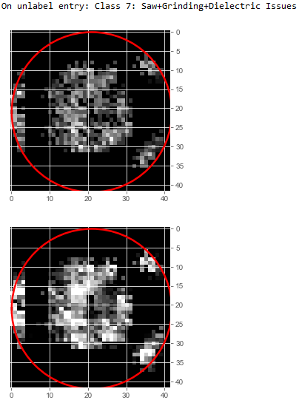
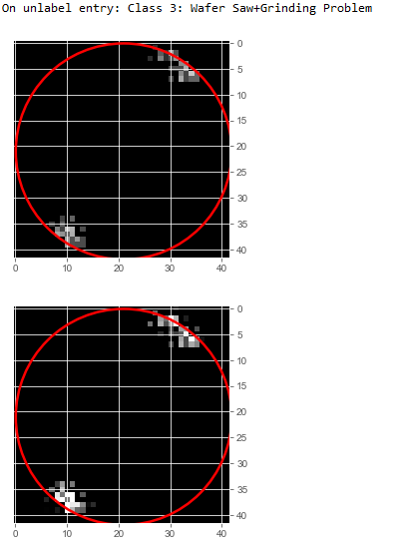
Result – Classifier Prediction

